Slide 1
Creating (Pretty) Science Posters Using PowerPoint melissa d. smith

Slide 2
A Scientific Poster is…
An advertisement of all your hard work
An illustrated “story”
Different/better than a talk!
Not everyone is great at giving talks (ahem)
Interactive
Larger audience even potentially when you’re not around (read: hanging in the halls for the next ten+ years)

Slide 3
A Scientific Poster should be:
Readable (from 3-6 feet away)
Easy to follow
Engaging

Slide 4
The Basics
Portrait or landscape?
Landscape is best in most cases
Dimensions
Larger poster isn’t always better
Check specs before you begin!

Slide 5
Standard Dimensions
48”
36”

Slide 6
1” empty space on all sides**
46”
34”
** or at the very least ½”

Slide 7
Guides = Your friends.
Make sure your guides are turned on
Right click -> Grid/Guides -> Display guides on screen
Additional guides
Grab existing guide + CTRL = New guide
Measures how far apart guides are
Grid settings/spacing
“Smart Guides”

Slide 8
Images
Insert only high-quality images (Pixel-y images won’t magically print nicely)
All photos should have a fine line frame
Background
Photo? Gradient? Solid color?
Busy is not better
Be kind to your text And your audience’s eyeballs

Slide 9
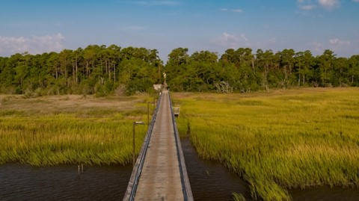

Fine Line
.25 or .5 pt contrasting line around photos

Slide 10
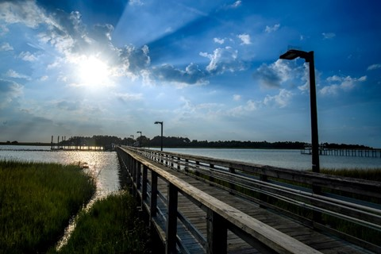

Fine Line
.25 or .5 pt contrasting line around photos

Slide 11
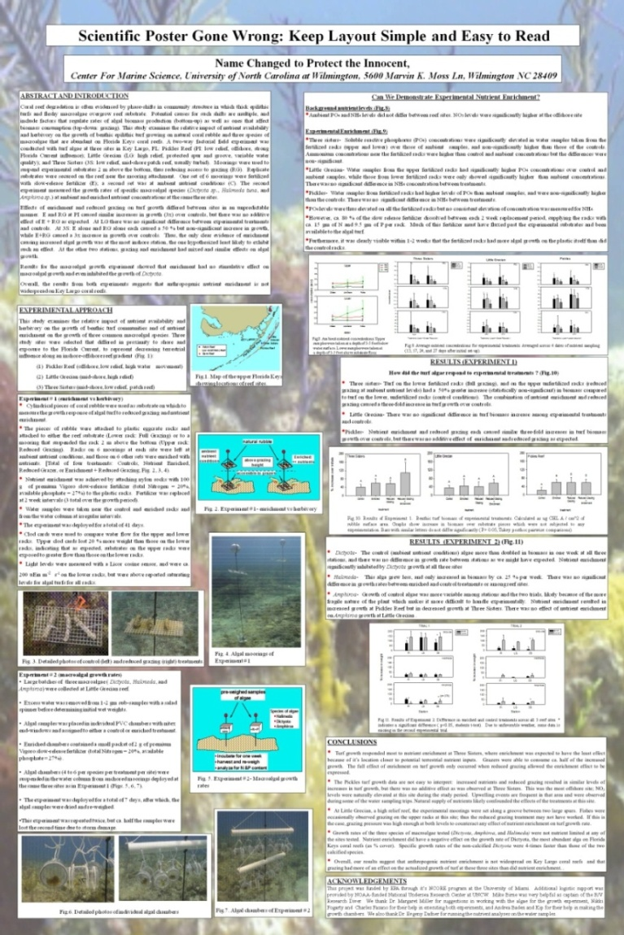
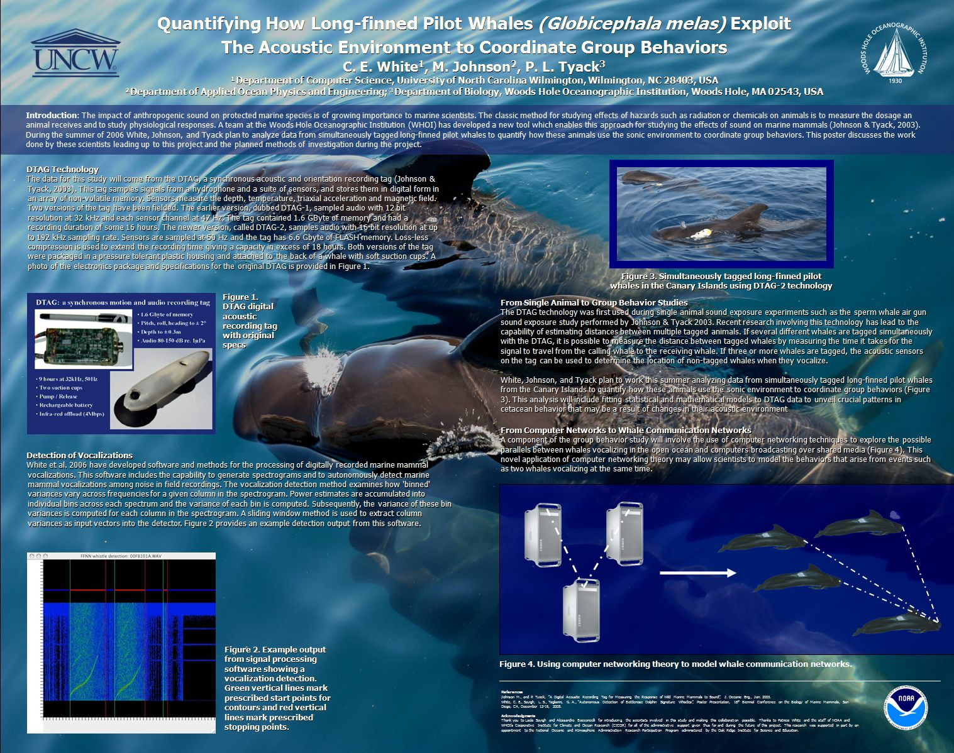
Photo Backgrounds
B. Beautiful photo, very unreadable
A. Just too much

Slide 12
Text
How much text?
Bullets
Columns = shorter lines of text = ideal
Edit, edit, edit. Then ask someone else to edit. Then edit again.
Left justify
Body text black
Let headings + title add color
#betterposter movement?

Slide 13
#betterposter Movement
“Ammo bar”
YouTube/Mike Morrison

Slide 14
Very Loosely Suggested Font Sizes
Title (80 pt)
Heading (38 pt)
Subheading (32 pt)
Body Text (28 pt)

Slide 15
Very Loosely Suggested Font Sizes
Do not make your figure captions tiny.
Same goes for chart text.

Slide 16
Serif vs. Sans-Serif Fonts
E
E
Serif (times new roman)
Sans-Serif (arial)

Slide 17
Good Font, Bad Font*
Sans Serif (Headings/Titles):
Arial, Trebuchet, Calibri, Century Gothic, Aptos
Serif (Body Text):
Times New Roman, Georgia, Garamond
*I will always, always replace Comic Sans with another font.

Slide 18
Fonts + Charts/Graphs
Special fonts -> export as images (ChemDraw, SigmaPlot, GIS, formulas, etc)
Try to make chart font match rest of text (this requires some planning ahead)
Charts can and do get weird Cut -> Paste Special -> PNG

Slide 19
Text Miscellany
Never use ALL CAPS in title
Bold or shadow to emphasize
TABS
Bold > Underlining
Internal margins = empty space
Bulleted list before/after spacing
Vertical alignment in tables
Y | N
N | Y

Slide 20
Internal Margins
.3 pt margin
The principal task of the scientific illustrator is to prepare accurate renderings of scientific subjects. These illustrations are designed for reproduction in professional or popular journals in the field of natural sciences, textbooks, as museum exhibits, web sites, and many other applications.
Scientific illustrations in both traditional and digital formats provide a visual explanation and aid the viewer by clarifying complex descriptive information. The function of a scientific illustration, therefore, is essentially a practical one: to inform, to explain, and to instruct — in short, to communicate.
The principal task of the scientific illustrator is to prepare accurate renderings of scientific subjects. These illustrations are designed for reproduction in professional or popular journals in the field of natural sciences, textbooks, as museum exhibits, web sites, and many other applications.
Scientific illustrations in both traditional and digital formats provide a visual explanation and aid the viewer by clarifying complex descriptive information. The function of a scientific illustration, therefore, is essentially a practical one: to inform, to explain, and to instruct — in short, to communicate.

Slide 21
While We’re On the Subject…
The principal task of the scientific illustrator is to prepare accurate renderings of scientific subjects. These illustrations are designed for reproduction in professional or popular journals in the field of natural sciences, textbooks, as museum exhibits, web sites, and many other applications.
Scientific illustrations in both traditional and digital formats provide a visual explanation and aid the viewer by clarifying complex descriptive information. The function of a scientific illustration, therefore, is essentially a practical one: to inform, to explain, and to instruct — in short, to communicate.
The principal task of the scientific illustrator is to prepare accurate renderings of scientific subjects. These illustrations are designed for reproduction in professional or popular journals in the field of natural sciences, textbooks, as museum exhibits, web sites, and many other applications.
Scientific illustrations in both traditional and digital formats provide a visual explanation and aid the viewer by clarifying complex descriptive information. The function of a scientific illustration, therefore, is essentially a practical one: to inform, to explain, and to instruct — in short, to communicate.

Slide 22
Justified vs Left Aligned
The principal task of the scientific illustrator is to prepare accurate renderings of scientific subjects. These illustrations are designed for reproduction in professional or popular journals in the field of natural sciences, textbooks, as museum exhibits, web sites, and many other applications.
Scientific illustrations in both traditional and digital formats provide a visual explanation and aid the viewer by clarifying complex descriptive information. The function of a scientific illustration, therefore, is essentially a practical one: to inform, to explain, and to instruct — in short, to communicate.
The principal task of the scientific illustrator is to prepare accurate renderings of scientific subjects. These illustrations are designed for reproduction in professional or popular journals in the field of natural sciences, textbooks, as museum exhibits, web sites, and many other applications.
Scientific illustrations in both traditional and digital formats provide a visual explanation and aid the viewer by clarifying complex descriptive information. The function of a scientific illustration, therefore, is essentially a practical one: to inform, to explain, and to instruct — in short, to communicate.

Slide 23
Graphics > Text
Consider presenting as much info as possible graphically
Bar/pie charts (data)
Flow chart (processes, questions/answers)
Timeline (history, chronology, future plans)
Maps (spatial relationships)
“Information is beautiful”
50-50 split = ideal

Slide 24
References, an eyesore
Can be smaller font size
Heading can be smaller than others
My go-to move:
QR code link instead - e.g. myqrcode.com
References
Bellinger, J.W. and J.W. Avault Jr. 1970. Seasonal Occurrence, Growth, and Length-Weight Relationship of Juvenile Pompano, Trachinotus carolinus, in Louisiana. Transactions of the American Fisheries Society 2: 353-358
Bellinger, J.W. and J.W. Avault Jr. 1971. Food Habits of Juvenile Pompano, Trachinotus carolinus, in Louisiana. Transactions of the American Fisheries Society 3: 486-494
Cortes, E. 1997. A Critical Review of Methods of Studying Fish Feeding Based on Analysis of Stomach Contents: Application to Elasmobranch fishes. Canadian Journal of Fisheries and Aquatic Sciences 54:726-738
DeLancey, L.B. 1989. Trophic Relationship in the Surf Zone During the Summer at Folly Beach, South Carolina. Journal of Coastal Research 5: 477-488

